Slide 1
Photomicrographs of Plant foods
Squash: Zucchini
Permission to reproduce original photomicrographs used to make this collection may be obtained from
Dr. David O. Norris at
david.norris@colorado.edu

Slide 2
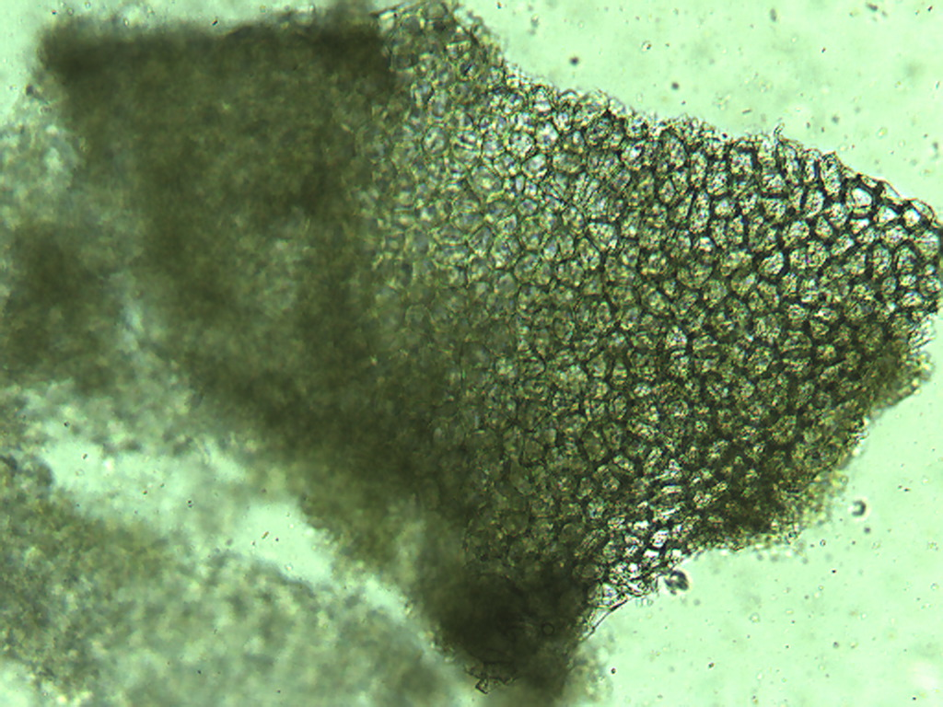
Notes:
459. Cucurbita pepo L. Squash, zucchini. Skin epidermal cells, unstained, 10X

Slide 3
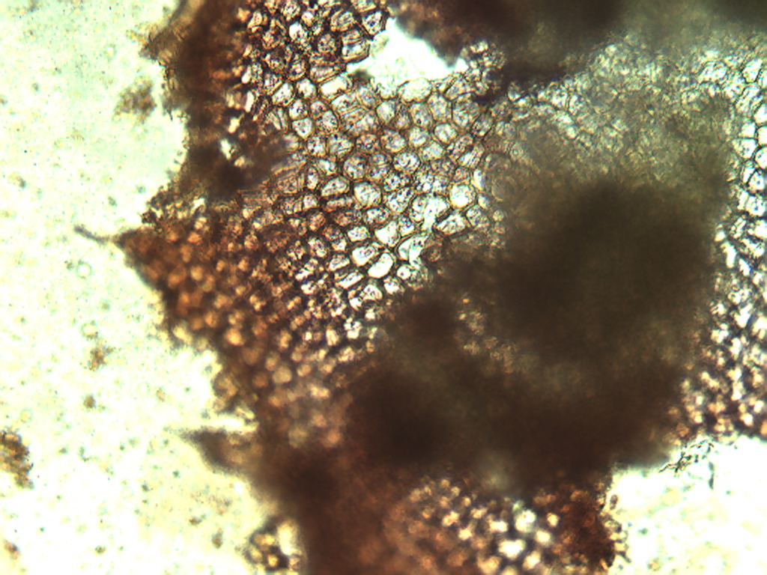
Notes:
460. Squash, zucchini. Skin epidermal cells, stained with safranin, 10X.

Slide 4
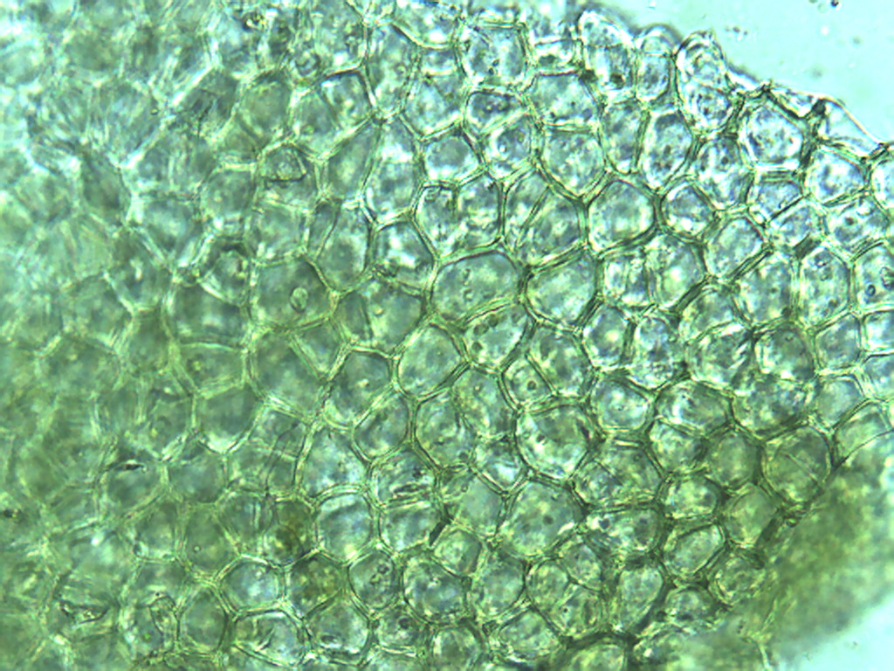
Notes:
461. Squash, zucchini. Skin epidermal cells, unstained, 25X.

Slide 5
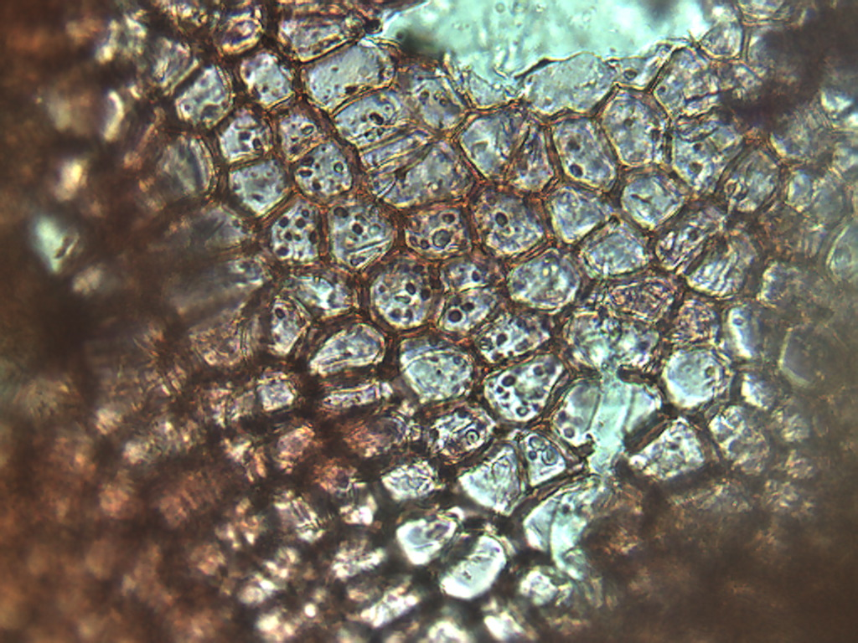
Notes:
462. Squash, zucchini. Skin epidermal cells, stained with safranin, 25X.

Slide 6
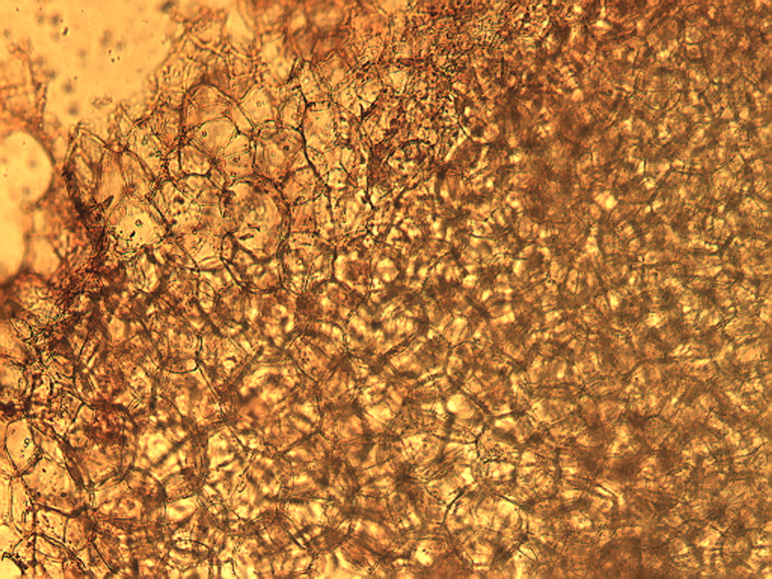
Notes:
463. Squash, zucchini. Pulp parenchymal cells stained with safranin, 10X.

Slide 7
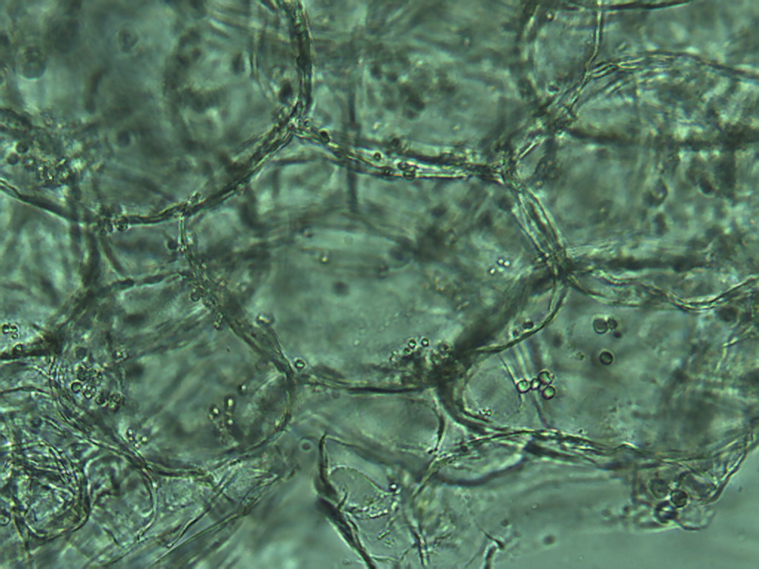
Notes:
464. Squash, zucchini. Parenchymal pulp cells, unstained. 25X.

Slide 8
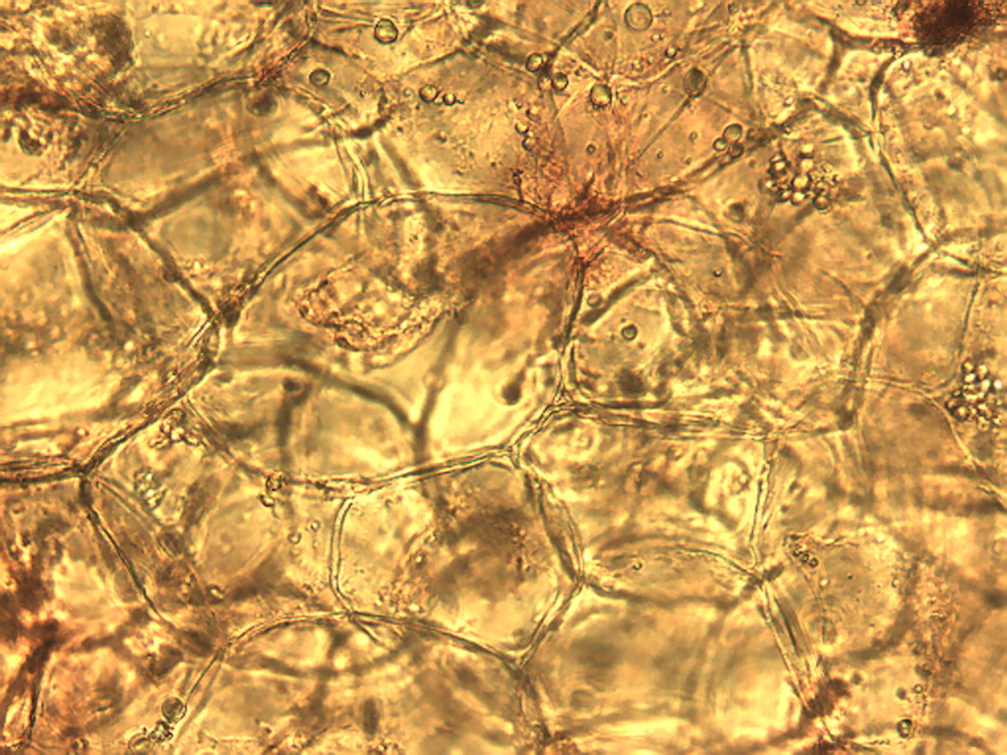
Notes:
465. Squash, zucchini. Parenchymal pulp cells stained with safranin, 25X.

Slide 9
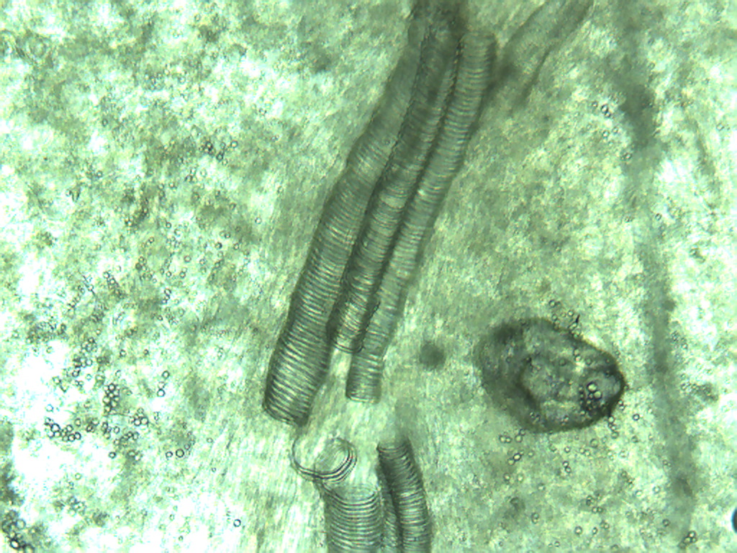
Notes:
466. Squash, zucchini. Vessels in pulp, 10X.

